Slide 1
Nourriture - Connect People with Ingredients
fastDev@Android Testing

Slide 2
Outline
Android Test Framework
Activity Testing Tutorial
Improve the Code with Lint

Slide 3
Key Features
Android test suites are based on Junit
Test suites are contained in test packages, which just like app packages
The Android JUnit extensions provide component-specific test case classes, just like activity, service, provider, etc
Building and tests are available both in Eclipse with ADT and via command line

Slide 4
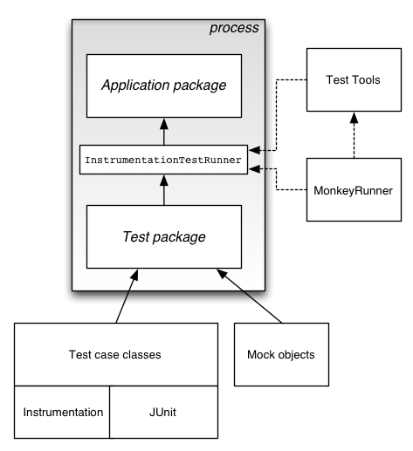
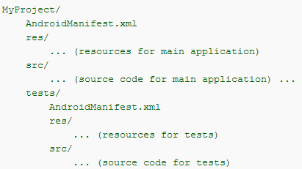
Test Framework

Slide 5
Package: junit.framework
//Implement a subclass of TestCase
public class MathTest extends TestCase { protected double fValue1; protected double fValue2; protected void setUp() { fValue1= 2.0; fValue2= 3.0; }
//Implement a test method
public void testAdd() { double result= fValue1 + fValue2; assertTrue(result == 5.0); }
}
// run the tests
TestCase test= new MathTest("add") { public void runTest() { testAdd();
}
};
test.run();

Slide 6
Package: android.test
InstrumentationTestRunner
An Instrumentation that runs various types of TestCase against an Android package (application).
InstrumentationTestCase
A test case that has access to Instrumentation
ActivityTestCase
support Activity test cases
ProviderTestCase2
support testing a single ContentProvider and testing app code with an isolated content provider.
ServiceTestCase
support for the lifecycle of a Service, and hooks with which we can inject various dependencies in which your Service is tested.
AndroidTestCase
access Resources or other things that depend on Activity Context
…

Slide 7
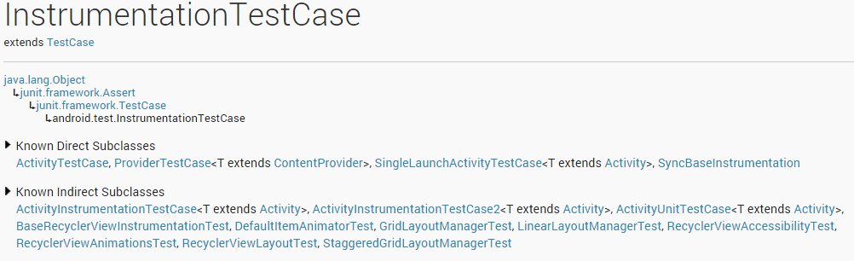
What InstrumentationTestCase

Slide 8
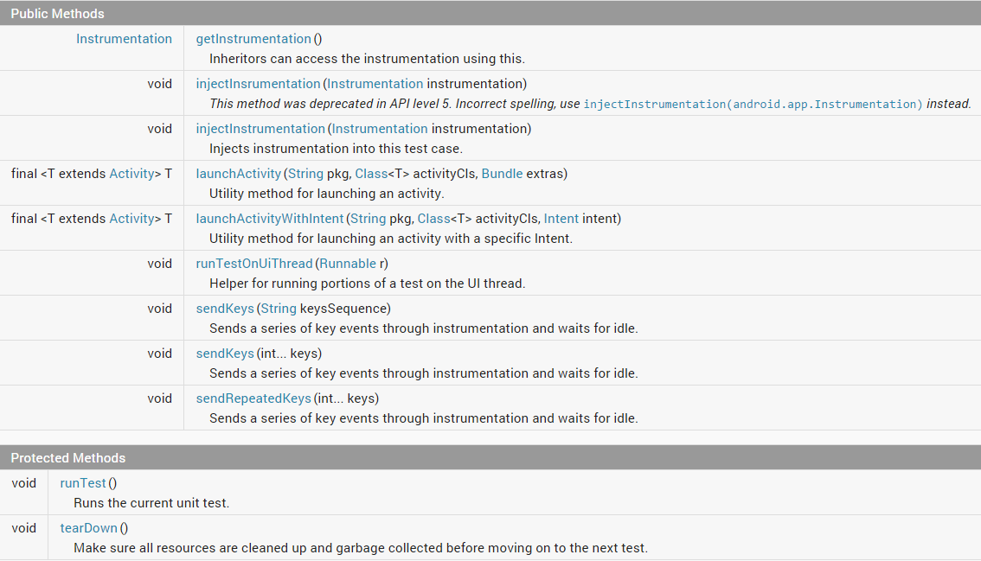
Features of InstrumentationTestCase

Slide 9
What Instrumentation
Package: android.app
Android instrumentation is a set of control methods or "hooks" in the Android system, which control an Android component independently of its normal lifecycle
When running with instrumentation turned on, this class will be instantiated for you before any of the application code, allowing you to monitor all of the interaction the system has with the application, for example: callActivityOnCreate, etc
An Instrumentation implementation is described to the system through an AndroidManifest.xml's <instrumentation> tag

Slide 10
Instrumentation == Hook
// Start the main activity of the application under test
mActivity = getActivity();
// Get a handle to the Activity object's main UI widget, a Spinner
mSpinner = (Spinner)mActivity.findViewById(com.android.example.spinner.R.id.Spinner01); // Set the Spinner to a known position mActivity.setSpinnerPosition(TEST_STATE_DESTROY_POSITION); // Stop the activity - The onDestroy() method should save the state of the Spinner mActivity.finish(); // Re-start the Activity - the onResume() method should restore the state of the Spinner mActivity = getActivity(); // Get the Spinner's current position int currentPosition = mActivity.getSpinnerPosition(); // Assert that the current position is the same as the starting position assertEquals(TEST_STATE_DESTROY_POSITION, currentPosition);

Slide 11
Other Utilities
The SDK also provide us
Monkey: A program that runs on emulator or device and generates pseudo-random streams of user events and a number of system-level events.
Uiautomator: A Java library containing APIs to create customized functional UI tests, and an execution engine to automate and run the tests.
…

Slide 12
Other Utilities - Monkey
Basic configuration options, such as the number of events
Operational constraints, such as restricting the test to a app
Event types and frequencies
Debugging options
Syntax:
$ adb shell monkey [options] <event-count>
Example:
$ adb shell monkey -p your.package.name -v --throttle 500 5000
Each -v on the command line will increment the verbosity level
Inserts a fixed delay between events. If not specifiedevents are generated as rapidly as possible
NB of Events
Req1: No ANR and App crash during monkey testing (with above command).
http://developer.android.com/tools/help/monkey.html

Slide 13
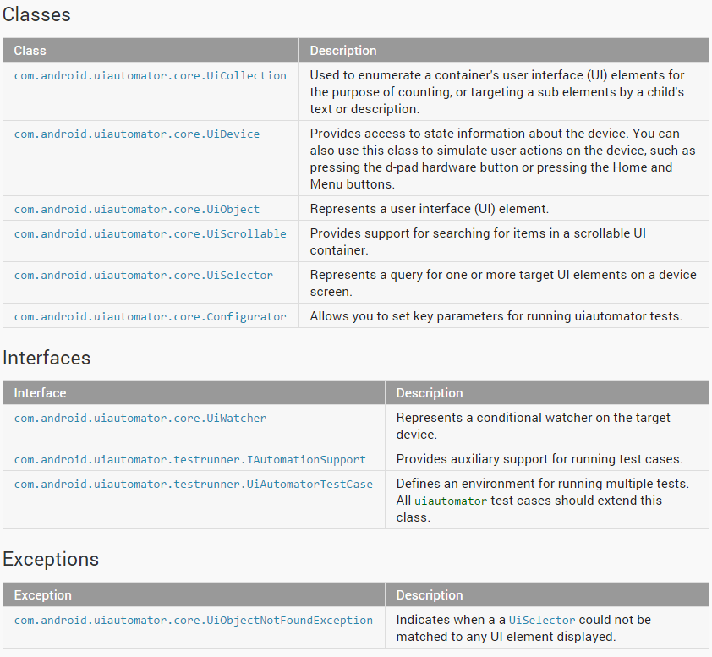
Other Utilities – Uiautomator API

Slide 14
Other Utilities - Uiautomator
It is used to test the behavior of your application’s user interface (UI) on a device. public class LaunchSettings extends UiAutomatorTestCase { public void testDemo() throws UiObjectNotFoundException { // Simulate a short press on the HOME button. getUiDevice().pressHome(); // use this property to create a UiSelector to find the button. UiObject allAppsButton = new UiObject(new UiSelector().description("Apps")); // Simulate a click to bring up the All Apps screen. allAppsButton.clickAndWaitForNewWindow(); // we create a UiSelector to find a tab with the text label “Apps”. UiObject appsTab = new UiObject(new UiSelector().text("Apps")); // Simulate a click to enter the Apps tab. appsTab.click(); // we can use a UiScrollable object to do swiping until reach to settings app icon. UiScrollable appViews = new UiScrollable(new UiSelector().scrollable(true)); // Set the swiping mode to horizontal (the default is vertical) appViews.setAsHorizontalList(); // Create a UiSelector to find the Settings app and simulate a user click to launch the app. UiObject settingsApp = appViews.getChildByText(new UiSelector() .className(android.widget.TextView.class.getName()), "Settings"); settingsApp.clickAndWaitForNewWindow(); // Validate that the package name is the expected one UiObject settingsValidation = new UiObject(new UiSelector().packageName("com.android.settings")); assertTrue("Unable to detect Settings", settingsValidation.exists()); } }
ant build
adb push <path_to_output_jar> /data/local/tmp/
adb shell uiautomator runtest <testproject>.jar -c <testprojectpackage>
Create UI object according to query of UI element by setting the search criteria
Req2: Automate some test cases for major user scenarios of app

Slide 15
Outline
Android Test Framework
Activity Testing Tutorial
Improve the Code with Lint

Slide 16
Manifest
<?xml version="1.0" encoding="utf-8"?> <manifest xmlns:android="http://schemas.android.com/apk/res/android" package="com.android.example.spinner.test" android:versionCode="1" android:versionName="1.0"> <uses-sdk android:minSdkVersion="3" /> <instrumentation android:targetPackage="com.android.example.spinner" android:name="android.test.InstrumentationTestRunner" /> <application android:icon="@drawable/icon" android:label="@string/app_name"> <uses-library android:name="android.test.runner" /> ... </application> </manifest>

Slide 17
Test Setup
private SpinnerActivity mActivity;
private Spinner mSpinner;
private SpinnerAdapter mPlanetData;
public static final int ADAPTER_COUNT = 9;
public SpinnerActivityTest extends ActivityInstrumentationTestCase2() {
@Override protected void setUp() throws Exception { //test initialization super.setUp(); setActivityInitialTouchMode(false); mActivity = getActivity(); mSpinner = (Spinner) mActivity.findViewById(com.android.example.spinner.R.id.Spinner01); mPlanetData = mSpinner.getAdapter(); } // end of setUp() method definition
public void testPreConditions() { // the test case #1 assertTrue(mSpinner.getOnItemSelectedListener() != null); assertTrue(mPlanetData != null); assertEquals(mPlanetData.getCount(), ADAPTER_COUNT); //assert } // end of testPreConditions() method definition
}

Slide 18
Test Case
public static final int INITIAL_POSITION = 0;
public static final int TEST_POSITION = 5;
public SpinnerActivityTest() {
private String mSelection; private int mPos;
public void testSpinnerUI() { // the test case #2
mActivity.runOnUiThread( new Runnable() { public void run() { mSpinner.requestFocus(); mSpinner.setSelection(INITIAL_POSITION); } // end of run() method definition } // end of anonymous Runnable object instantiation ); // end of invocation of runOnUiThread
this.sendKeys(KeyEvent.KEYCODE_DPAD_CENTER); for (int i = 1; i <= TEST_POSITION; i++) { this.sendKeys(KeyEvent.KEYCODE_DPAD_DOWN); } // end of for loop
this.sendKeys(KeyEvent.KEYCODE_DPAD_CENTER);
mPos = mSpinner.getSelectedItemPosition();
mSelection = (String)mSpinner.getItemAtPosition(mPos); TextView resultView = (TextView)mActivity.findViewById(com.android.example.spinner.R.id.SpinnerResult);
String resultText = (String) resultView.getText(); assertEquals(resultText, mSelection); //assert } // end of testSpinnerUI() method definition
}

Slide 19
Run Test
CLI:
adb install SpinnerActivityTest/bin/SpinnerActivityTest-debug.apk
adb shell am instrument -w com.android.example.spinner.test/android.test.InstrumentationTestRunner
The result of a successful test looks like this:
com.android.example.spinner.test.SpinnerActivityTest:.... Test results for InstrumentationTestRunner=.... Time: … OK (… tests)

Slide 20
Outline
Android Test Framework
Activity Testing Tutorial
Improve the Code with Lint

Slide 21
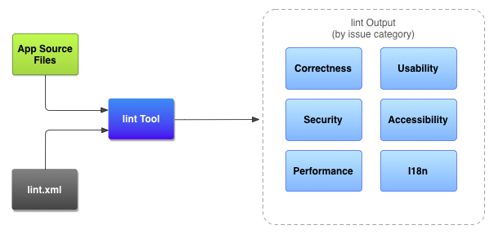
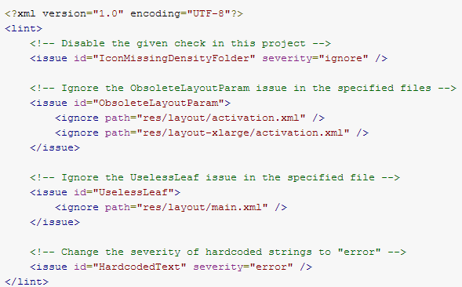
Lint
To ensure that code has no structural problems.
For example, if XML resource files contain unused namespaces, this takes up space and incurs unnecessary processing.
Other structural issues, such as use of deprecated elements or API calls that are not supported by the target API versions, might lead to code failing to run correctly.
Req3: Enable Lint check in the project and fix all issues in category of “error”

